Slide 1
ML Group Project Final Presentation:
Toys and Games Dataset
YB Choi, Ji-Qing Chen, Shan-Chang Lin, James Busch

Slide 2
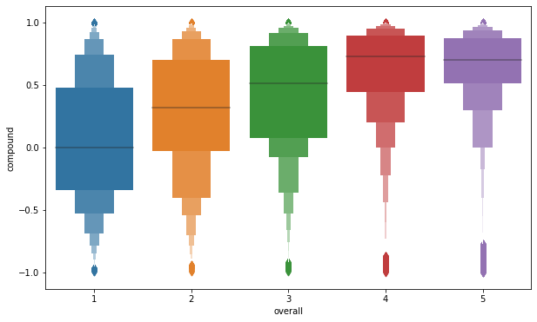
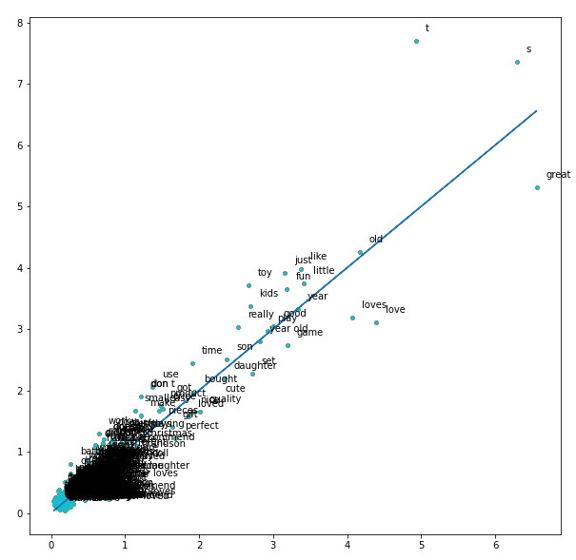
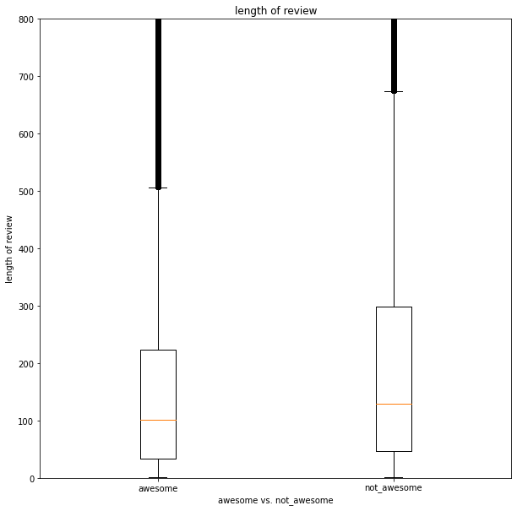
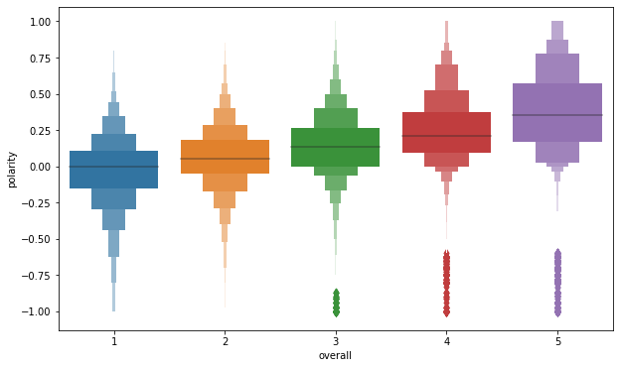
Previous Features Generated
Sentiment analysis (vader and textblob), review text cleaning, review feature generation, and grouping by rating (rather than product)
Sentiment Analysis
Term frequency per review
Length of Review Feature
Vader
TF of not awesome products
TextBlob
Term freq. of awesome products

Slide 3
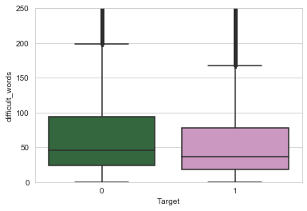
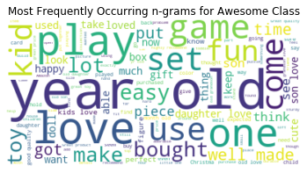
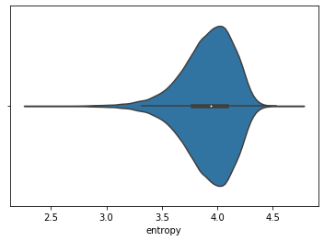
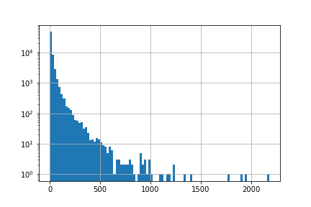
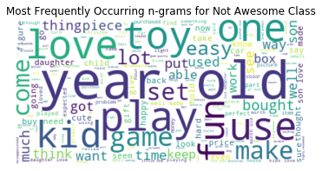
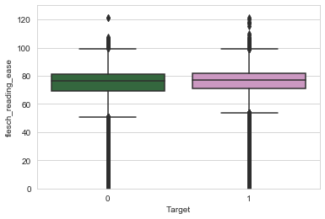
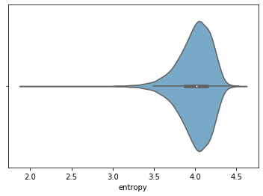
New Features Generated for Prediction
BoW: generation of n-grams (bi, tri and quadrigrams) from grouped review text
Entropy: entropy calculated for each review then averaged for each product
TextStat: text complexity measures (flesch_readability and difficult_words) generated from grouped review text
Review Count: # of reviews per product
TextStat
N-grams
Entropy
Review Count
Awesome
log(# of products)
Review count
Not Awesome

Slide 4
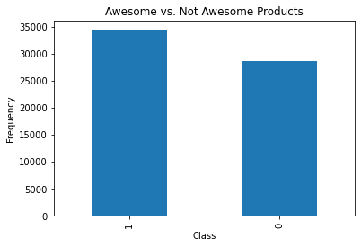
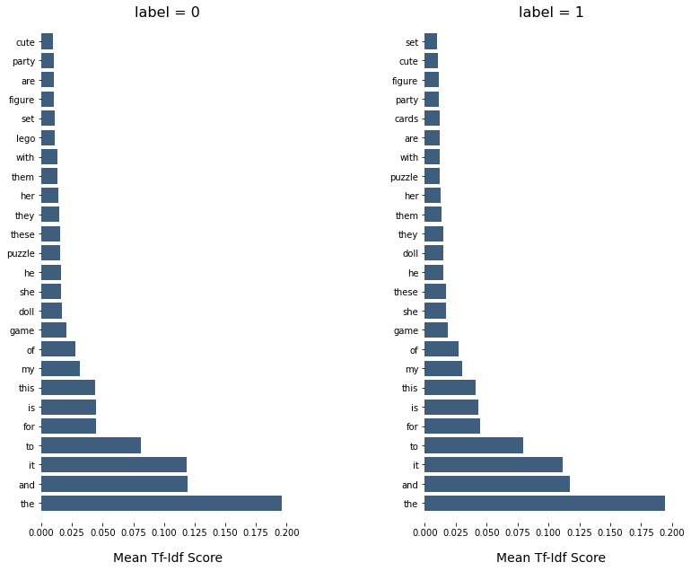
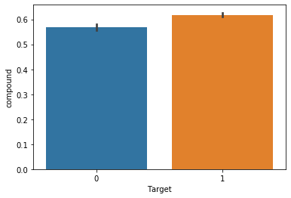
Best Features Generated for Prediction
Combining TFIDF + Vader Sentiment generated from grouped reviews by product
TFIDF: Feature generation from grouped review text without cleaning
Vader: sentiment scores from grouped review text without cleaning
TFIDF
Vader Sentiment

Slide 5
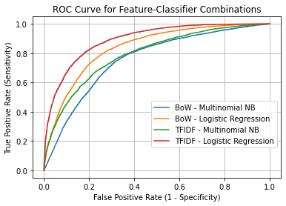
Previous Classifier-Feature Approaches
 | Precision | Recall | F-1
Vader - Logit | 0.60 | 0.78 | 0.68
TextBlob - Logit | 0.69 | 0.76 | 0.72
BoW - NB | 0.72 | 0.72 | 0.71
BoW - Logit | 0.77 | 0.77 | 0.77
TFIDF - NB | 0.72 | 0.72 | 0.71
TFIDF - Logit | 0.81 | 0.81 | 0.81
Best Classifier: Log. Regression using TFIDF features

Slide 6
New Approaches with below baseline F-1
Test_size = 0.2
Features - Classifier | Precision | Recall | F-1
BoW (unigram) - NB | 0.71 | 0.80 | 0.75
BoW (unigram) - Logit | 0.78 | 0.81 | 0.79
BoW - Logit Bagging | 0.54 | 1.00 | 0.70
Bigram - Logit | 0.76 | 0.80 | 0.78
Trigram - Logit | 0.76 | 0.80 | 0.78
Quadrigram - Logit | 0.76 | 0.80 | 0.78
Entropy - Logit | 0.57 | 0.84 | 0.68
textStat (flesch, difficult_words) - Logit | 0.55 | 0.92 | 0.69
TFIDF - NB | 0.70 | 0.83 | 0.76
TFIDF - Logit Bagging | 0.56 | 1.00 | 0.72
TFIDF - Logit Adaboost | 0.57 | 0.98 | 0.72

Slide 7
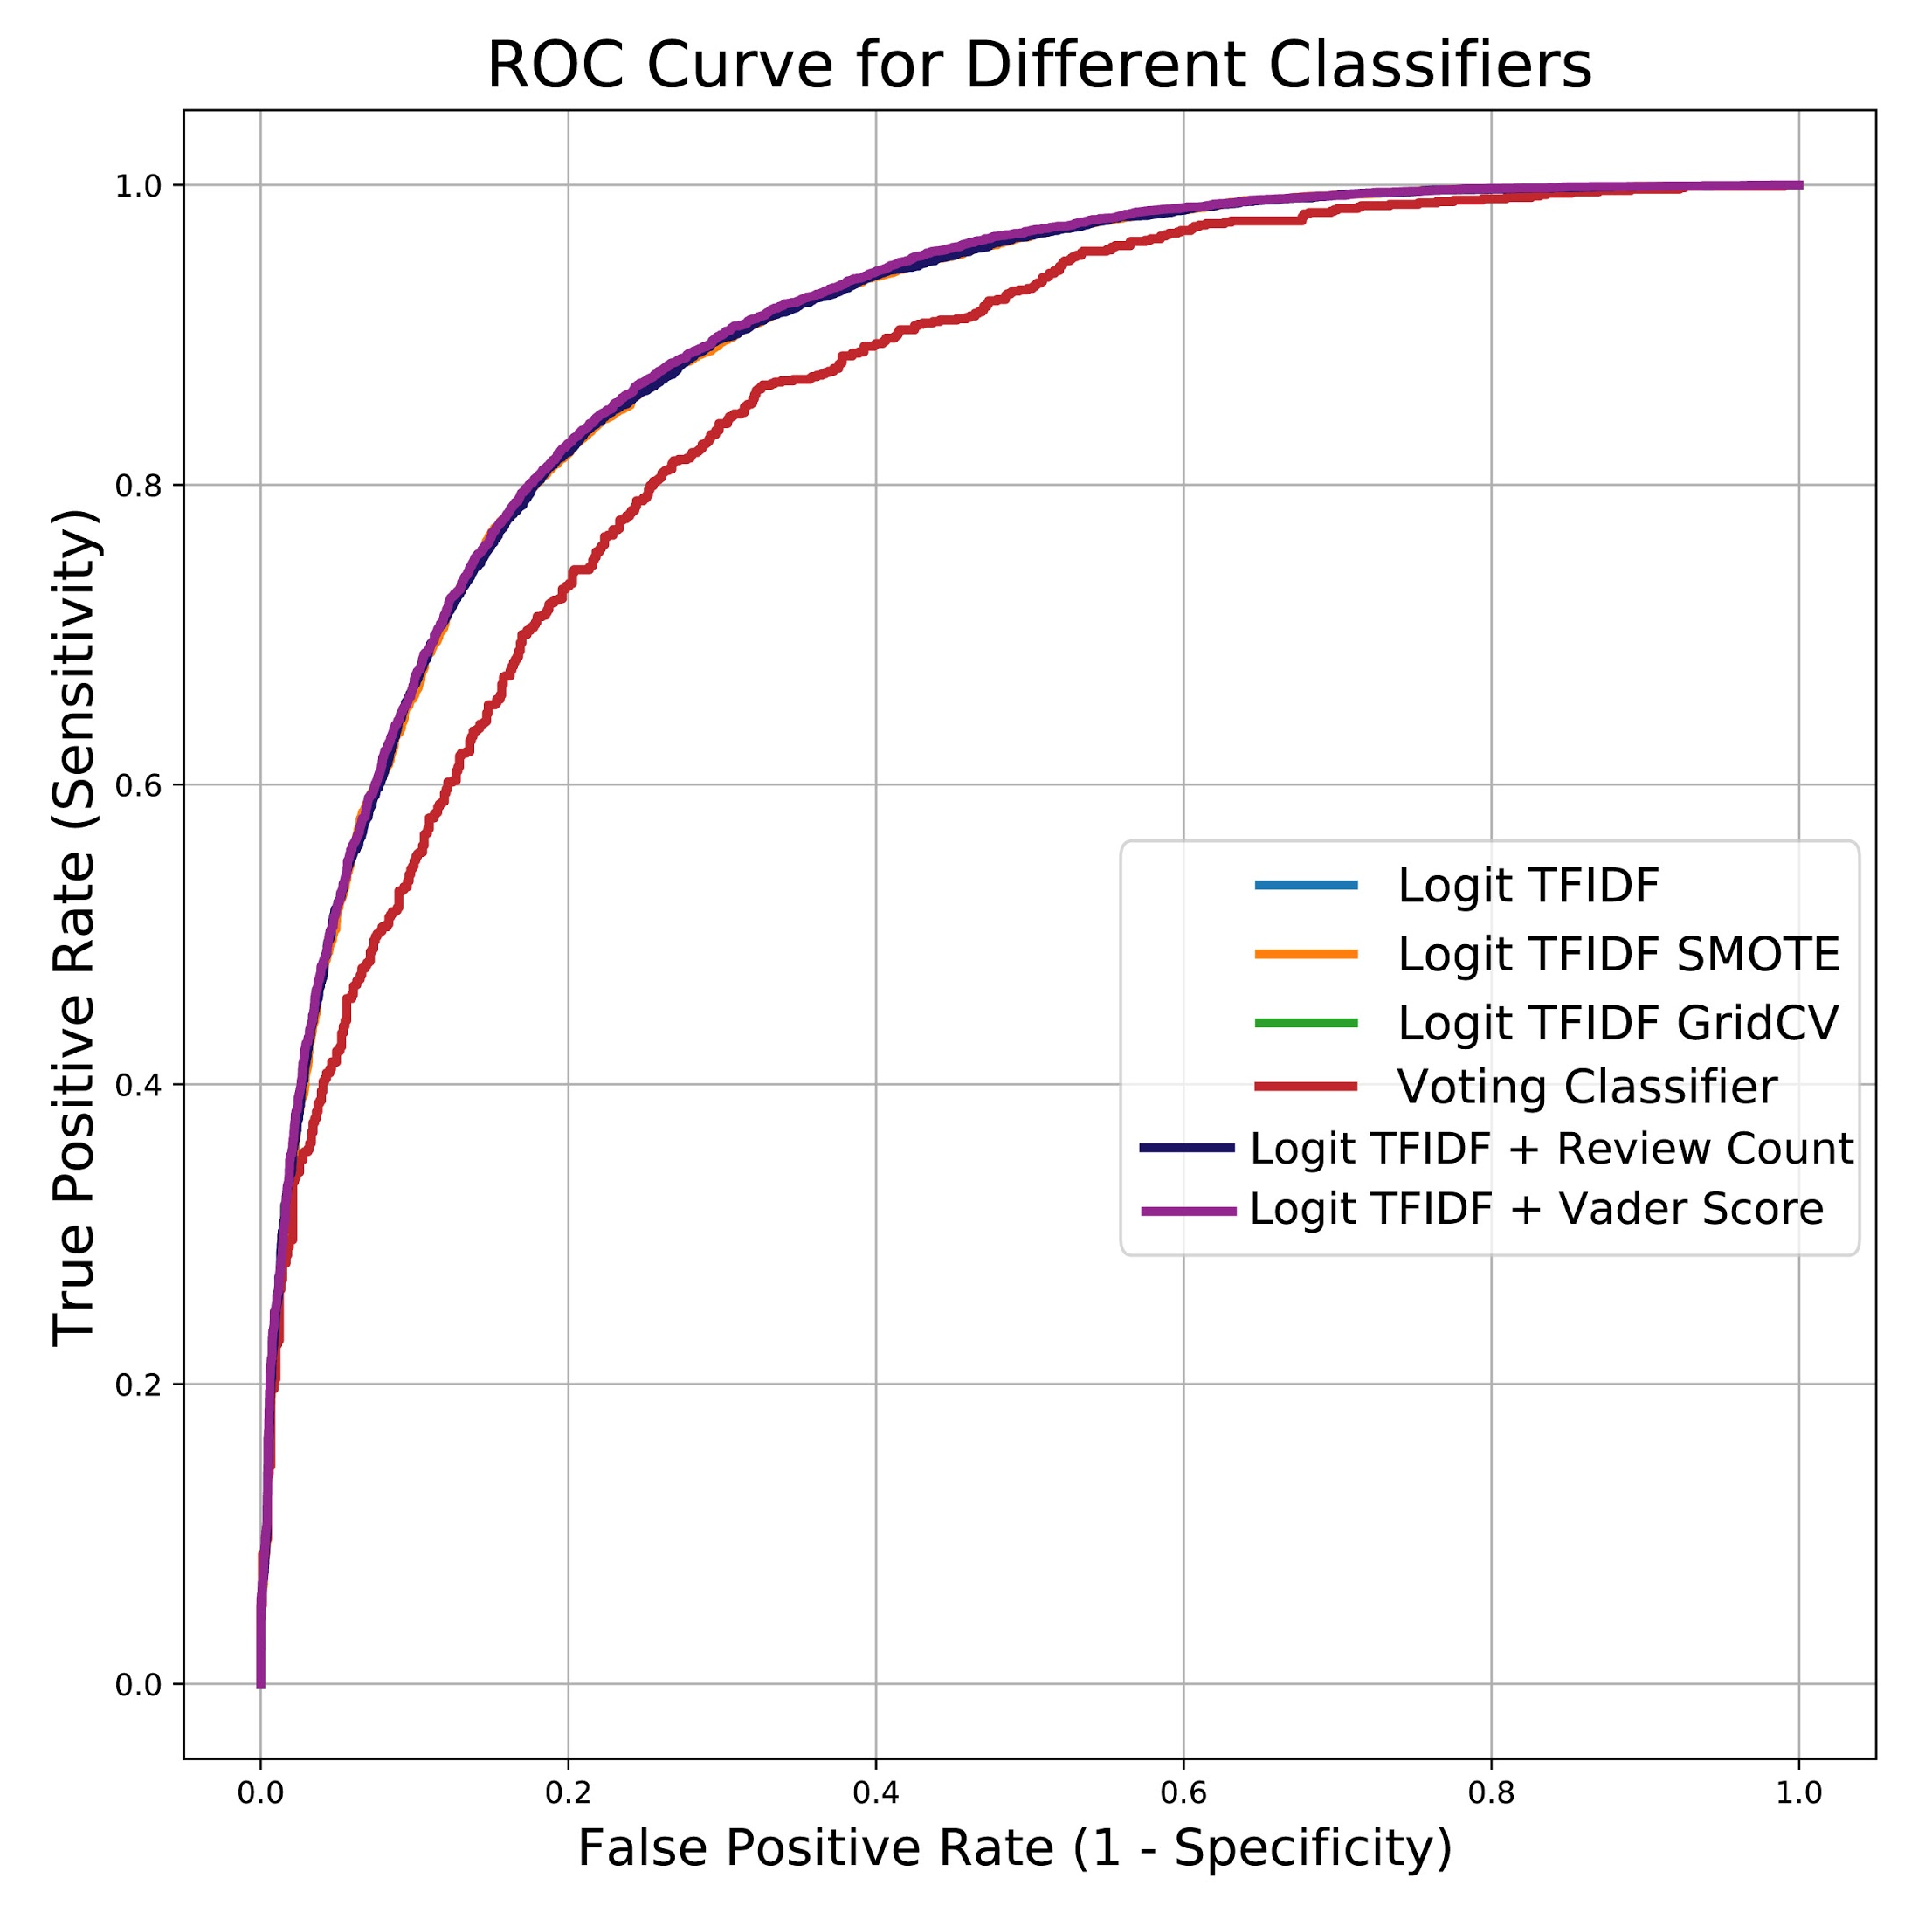
Cross validation for Top/above baseline F-1 Models
10-fold Cross Validation Accuracy
Features - Classifier | Precision | Recall | F-1
TFIDF - Logit SMOTE | 0.82 | 0.83 | 0.82
TFIDF + reviewCount - Logit | 0.82 | 0.85 | 0.83
TFIDF + VaderSenti - Logit | 0.82 | 0.85 | 0.84
TFIDF - Logit | 0.82 | 0.85 | 0.83
Best Classifier: TFIDF + Vader Sentiment - Logit!

Slide 8
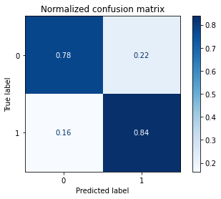
Confusion Matrix for Best Classifier
10-fold Cross Validation Average Metrics
 | Precision | Recall | F-1
TFIDF + VaderSenti - Logit | 0.82 | 0.85 | 0.84

Slide 9
Summary of Final Results
Hyperparameter optimization, class imbalance correction, and voting classifier did not improve performance from the TFIDF-Logit classifier feature combination (best model from deliverable 3)
Review text cleaning of any form decreased performance for all classifiers
Using TFIDF + Textblob sentiment features together improved our performance

Slide 10
Credits Slide
Group Contributions:
YB Choi - new feature generations (N-grams, entropy and TextStat), preliminary test of new features, data visualization, bagging classifier method
Ji-Qing Chen - late fusion, SMOTE, voting classifier methods, prediction file generation
Shan-Chang Lin - late fusion, SMOTE, voting classifier methods
James Busch - data visualization, classifier-feature combination testing, performance comparison, slides preparation

